Slide 1

^{Predicting Viral Success:}
Analyzing and Classifying YouTube Video Outliers Based on Title Patterns
^{Verónica Santamaría}
or Claudia Valero for our teacher

Slide 2
Index
1. Intro
3. Plotwist
5. Non-predictive
Models
2. API Youtube
4. Interesting insights
6. Next Steps

Slide 3



My brother and I were thinking about…
The goal of this project is to explore whether it is possible to predict the performance of a YouTube video (becoming a high-performing outlier) based solely on its title.

Slide 4
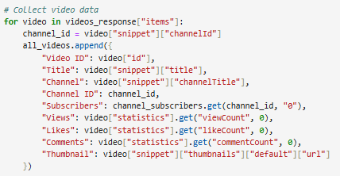
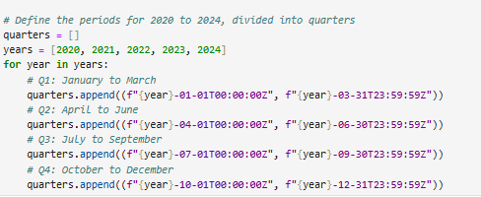
2. YouTube API
Columns of the dataset
Extracted by quarters
!
The API has a restriction of extracting a maximum of 500 rows per request.

Slide 5
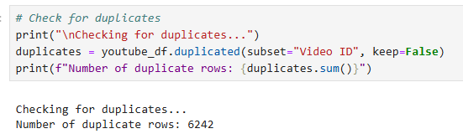

3. Plotwist
Data Cleaning
Out of how many?
6242 rows out of 6450 were duplicated.
What is the reason behind this?
The same video is captured multiple times during different API calls to YouTube, resulting in repeated entries with the same Video ID.
Solution?
Adding a code during the data loading process to filter out duplicate Video ID entries as they are being imported:

Slide 6

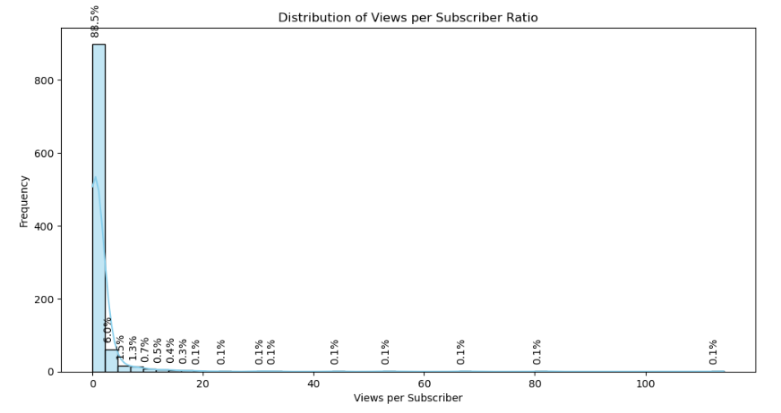
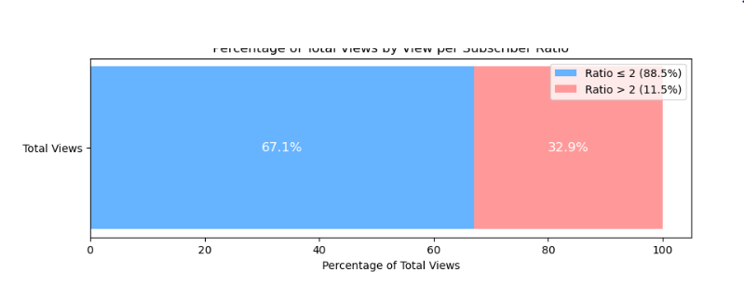
4. Interesting insights…
EDA
KPI: Views per Subscriber Ratio
Rating vs Price (Filtered with Z-score)
88.5% of videos have a Views per Subscriber ratio between 0-2, indicating that most videos perform in line with or slightly above their subscriber base
Outliers (11,5%) have a 33% of total views

Slide 7
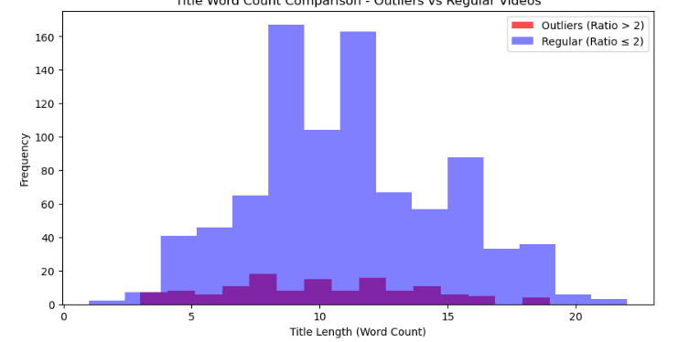
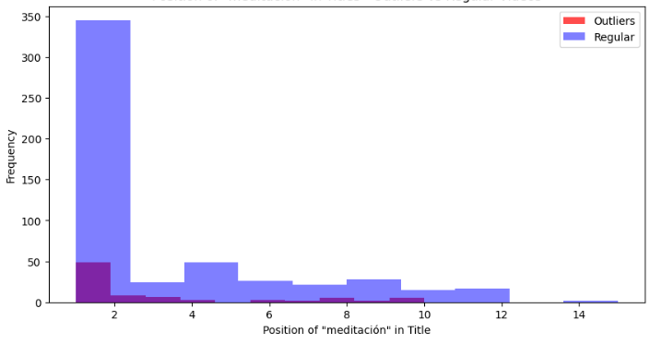
4. Interesting insights…
EDA
Title Length
Position of the Word "Meditación" in Titles
Outlier videos (ratio > 2) tend to have shorter titles compared to regular videos (ratio ≤ 2).
In outliers, while it also appears at the beginning, its position is more spread out across the title.

Slide 8
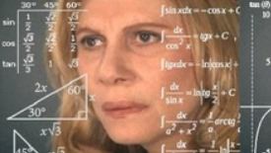
5. Non-predictive Models
My intention was to create classification models to predict which videos are likely to be outliers based on their titles and performance.
CLASSIFICATION
LOGISTIC REGRESSION | RANDOM FOREST
87% Accuracy | 85,9% Accuracy
87,1% Cross-V | 85,5% Cross-V

Slide 9
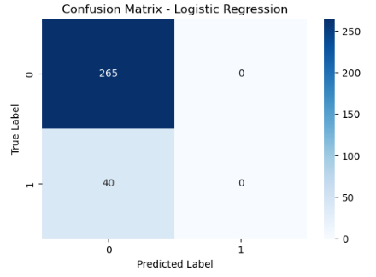
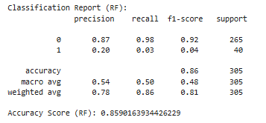
5. Non-predictive Models
LOGISTIC REGRESSION
87% Accuracy
87,1% Cross-V
RANDOM FOREST
85,9% Accuracy
85,5% Cross-V
Random Forest performs marginally better but both models struggle to predict outliers effectively, indicating severe class imbalance.

Slide 10
5. Next Steps
1. DATASET QUALITY
To increase the size of the dataset, we should add a loop during the data loading process to filter out duplicate Video ID entries as they are being imported
2. EDA
Outlier videos tend to: Use shorter and direct titles, vary the placement of the main keywords. Emphasize duration, personalization, and benefits in their titles. But, content and thumbnail should be also analyzed.
3. MODEL PERFORMANCE
Extract more information from videos to analyze the words in video titles more deeply.
Experiment with more complex models like Gradient Boosting or XGBoost, which may handle class imbalance better.

Slide 11

The End
Questions?

